Slide 1
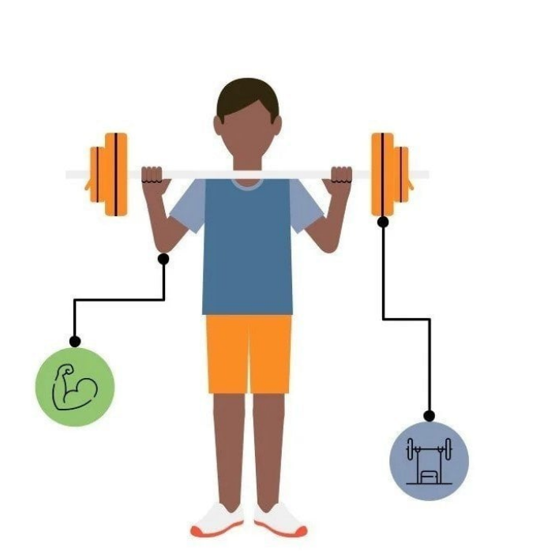
Fitness Tracker Dashboard with React, express, node js, mongo db

Slide 2
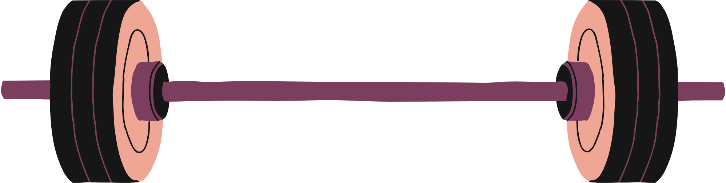
Agenda
01
02
03
04
Introduction
Project Analysis
Implementation and Testing
Future work

Slide 3
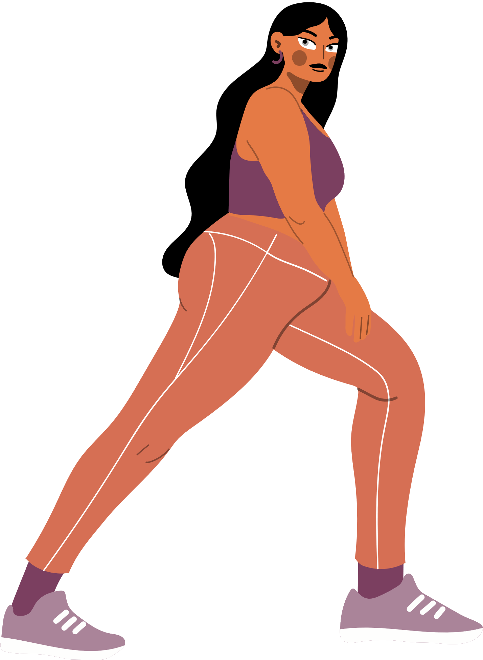
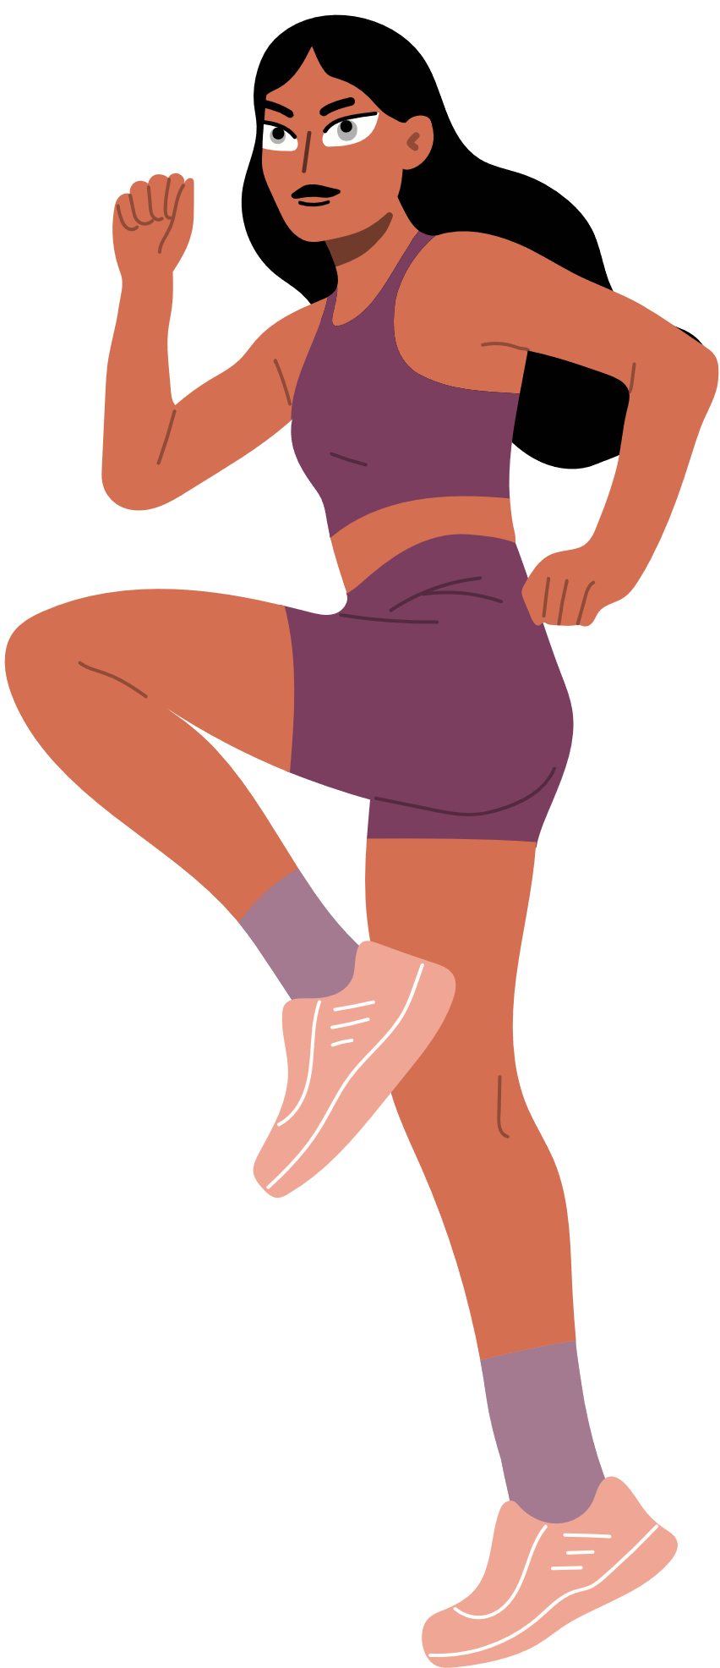
Introduction
Main Idea:
We aim to create a Software as a Service solution that can be purchased by any business owner or fitness gym. This software will allow them to offer a fitness app to their clients, where users can select the workouts they want to do, set their personal fitness goals, and track their progress over time.
Our fitness tracking website offers users real-time insights into their health through a simple, intuitive dashboard. It tracks activities like, target weight, steps, sleep, water intake, daily calories consumed, and calories burned. Users can easily compare their progress against personalized fitness goals, providing a comprehensive and accessible solution that stands out from other platforms.

Slide 4
Team Contributions
Fatma:
Implement Goals UI, Connect Goals frontend with backend, Implement setting tab, birthday and Upload image (frontend) .
Hossam:
Implement Authentication (frontend and backend), Implement layout UI, Implement setting tab, birthday and profile image (backend).
Mahitab:
Implement CRUD Operation in backend, Implement logs (all except workouts) frontend, connect logging frontend with backend.
Nahla:
Implement Logging UI, Implement progress tab & charts, Home UI (Implement goals progress tracking for users).

Slide 5
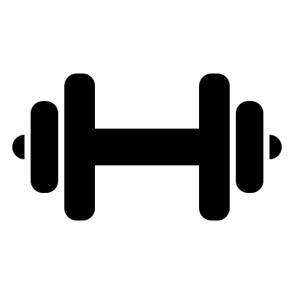

App requirements
Authentication & Authorization:
JWT authentication
Credentials (email, password)
authorization roles
Admin (service buyer)
Trainer: will register as a trainer but admin must approve to be trainer
Nutritionist : will register as a nutritionist but admin must approve
user (Client for service buyer)
Workouts:
user can log predefined workouts
user can log custom workout
admin and trainers can define public workouts
workout specs
targeted muscles
intensity
duration
calories burned
reps/duration

Slide 6
App requirements
Nutrition:
User can log predefined food
User can log custom food
Admin and trainers can define public foods
Food specs
Micro nutrients (protein, fat, carp)
Calories in whole
Quantity (weight)
Fast food or healthy food
Calories for every micro
Breakfast, dinner, snack, lunch
4. User Goals:
How many workouts goal (Daily, Weekly, Monthly)
Calories burned per Day
Calories intake per Day
Daily Sleep per Day
Daily Water intake
Target weight
Steps per Day

Slide 7
App requirements
Admin:
Configure application (set business name / logo)
Admins can create and update workout plans, similar to a trainer, and track client progress.
Manage Trainers and Nutritionists: Admins can add or remove trainers and nutritionists as needed.
Monitor Client Progress: Admins can track clients' progress in both nutrition and workouts.
User Management: Admins oversee trainers and nutritionists to ensure smooth operations.

Slide 8
App requirements
User :
the client (user) has the ability to log their activities and set goals related to their health and fitness. Here's what the user can do:
Logging Activities:
The user can log important health metrics such as:
Target Weight: Log the weight they want to reach.
Steps: Track daily steps taken, aiming for a step goal.
Sleep: Log hours of sleep to monitor sleep patterns and quality.
Water Intake: Keep track of daily water consumption.
Calories Intake/Day: Record how many calories are consumed each day.
Calories Burned/Day: Track the number of calories burned through daily activities or workouts.
Workouts: Log workout details, including type, duration, and intensity.

Slide 9

App requirements
User :
Set Goals:
The user can set personal goals in all the above categories:
Target Weight: Set a target weight they want to achieve over time.
Daily Steps: Set a daily step goal (e.g., 10,000 steps/day).
Sleep: Set a goal for the number of hours of sleep per night (e.g., 8 hours).
Water: Set a target for daily water intake, (e.g., drink 2 liters/day).
Calories Intake/Day: Set a goal for how many calories to consume each day.
Calories Burned/Day: Set a daily goal for calories burned through physical activity.
Workouts: Set workout goals, such as:
Frequency: Number of workouts per week (e.g., 4 times a week).
Duration: Target workout length (e.g., 45 minutes per day).

Slide 10
App requirements
Nutritionist:
Set Food: Nutritionists create food items (macronutrients, kcal).
Edit and Update: They can adjust food items.
Add New Food: New food can be added for variety or specific needs.
Track Progress: The system tracks client progress, like weight or health improvements.
Make Adjustments: Nutritionists modify food items as needed.

Slide 11
App requirements
Trainer :
Set Workouts: Trainers create workouts, like muscle building, endurance, or weight loss.
Edit and Update: Trainers can adjust workouts.
Track Progress: The system tracks client progress, like strength gains or weight loss.
Make Adjustments: Trainers modify workouts as needed to ensure clients stay on track.

Slide 12
Features
Authentication
JWT Authentication: Secure authentication for users.
Credential-Based Access: Users can log in using email and password.
Workout Management
Log Predefined Workouts: Users can log predefined workouts.
Workout Log Specifications:
Intensity
Calories burned
Repetitions (reps)/duration

Slide 13
Features
User Goals Tracking:
Set Workout Goals: Number of workouts per day, week or month (e.g., "4 times a week")
Calories Burned Goal: Set a daily goal for how many calories to burn.
Calories Intake Goal: Set a daily calorie intake target.
Sleep Goal: Set a goal for daily hours of sleep.
Water Intake Goal: Set a goal for daily water consumption (e.g., 2 liters per day).
Target Weight: Set a target weight to reach.
Steps Goal: Set a daily step target (e.g., 10,000 steps per day).

Slide 14
Features
User Features
Log Activities: Users can log their workouts, food intake, water intake, sleep hours, calories consumed, and calories burned.
Set Personal Goals: Users can set and update personal goals for:
Target weight
Daily steps
Daily calories intake and burned
Daily water consumption
Sleep hours
Workouts

Slide 15
Stage1 (Done)
Signup & Login (Authentication)
General Progress Tracking
Goals Progress Tracking
User can define Goals → Target weight, Steps, Sleep, Water, Calories intake/day, Calories burned/day, Workouts
User can log → Target weight, Steps, Sleep, Water, Calories intake/day, Calories burned/day, Workouts
Setting → User can edit profile data (Birth Day, profile picture)

Slide 16
Stage2 (Future work)
Add Admin:
Define public workouts, manage food, track client progress, manage trainers and nutritionists, and remove staff as needed.
Users can log custom workouts
Stage3 (Future work)
Add Trainer:
Add Workout, Edit Workouts, Delete Workouts, Track Client Progress, Manage Clients
Stage4 (Future work)
Add Nutrition & Nutritionist:
Add Predefined Food, Food Specifications

Slide 17
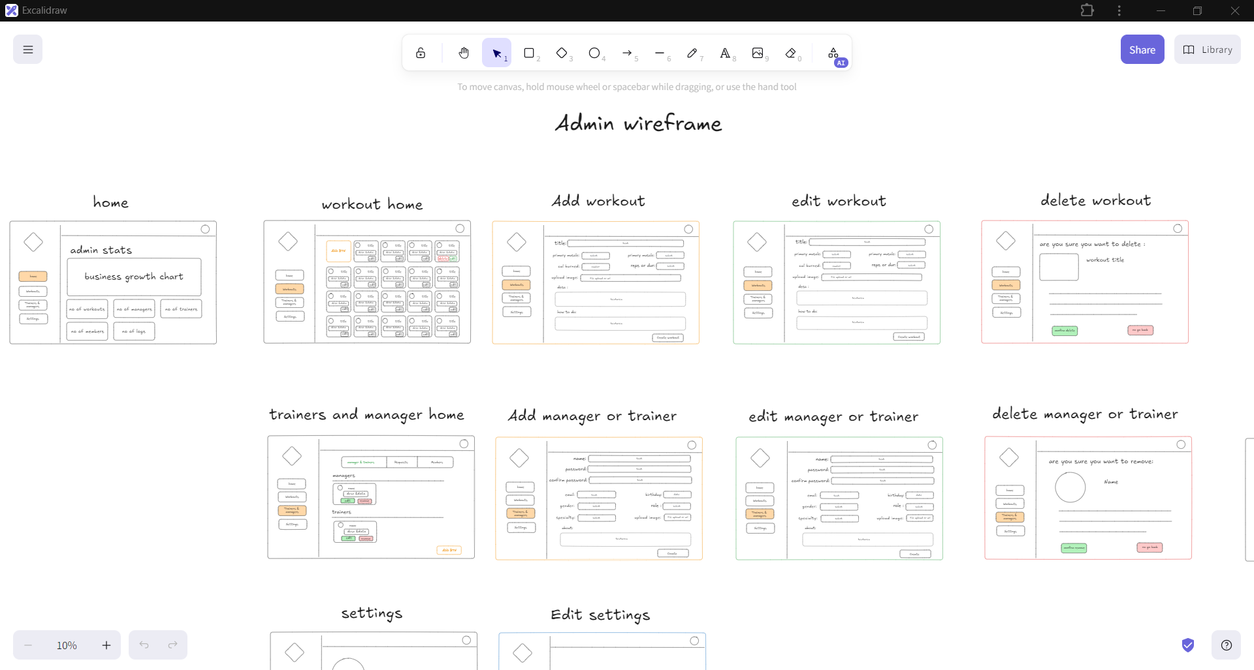
sample of wireframe

Slide 18
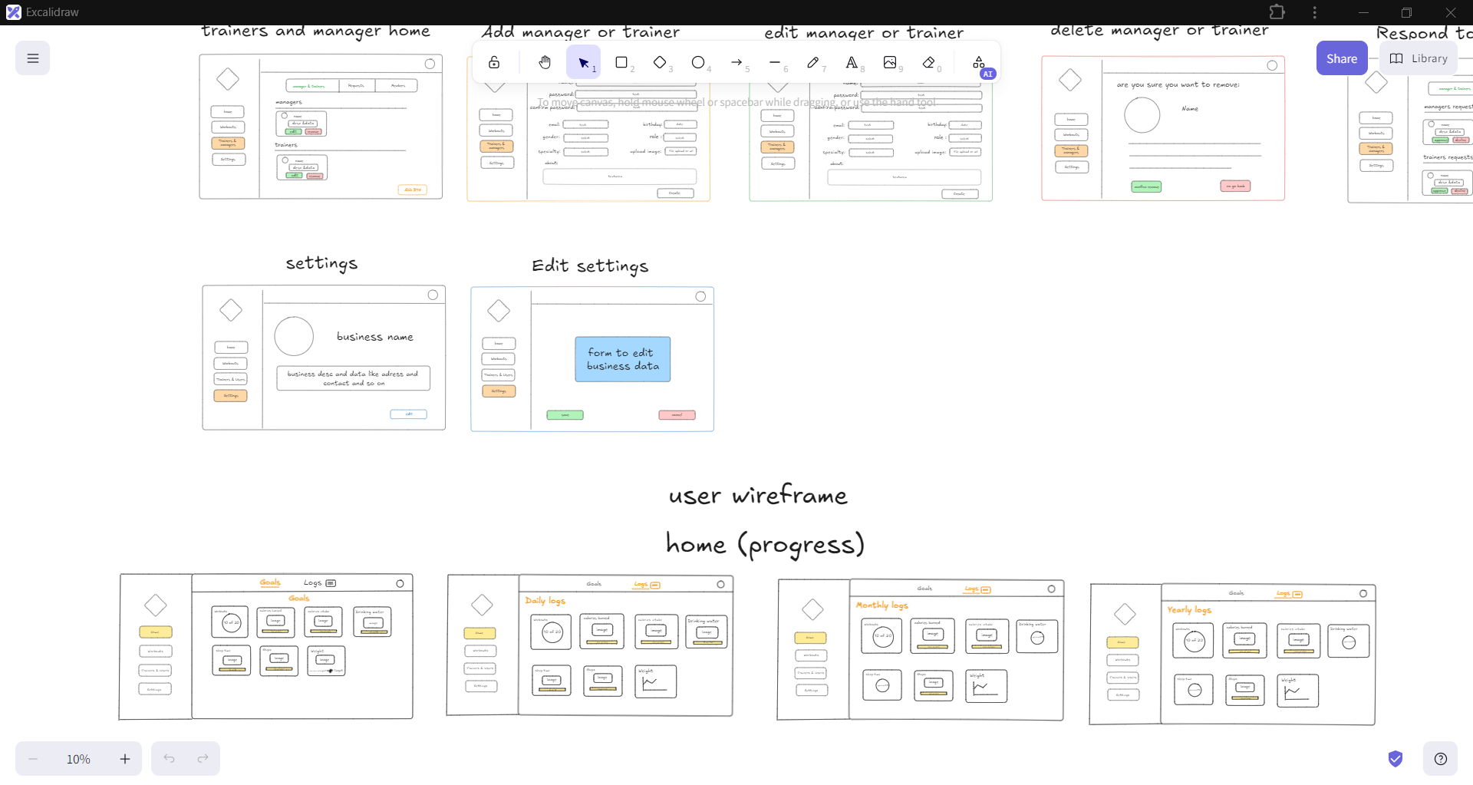
sample of wireframe

Slide 19
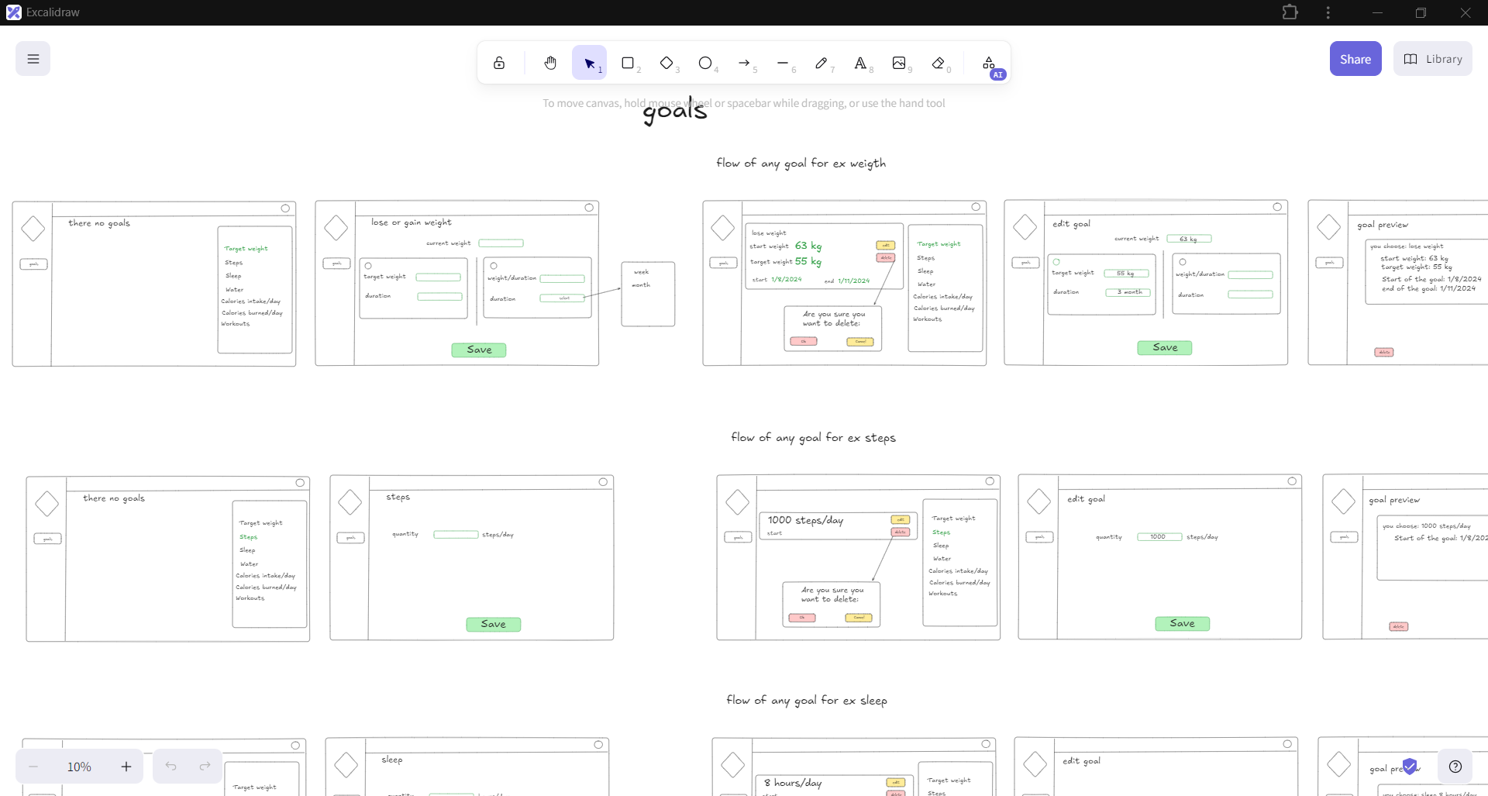
sample of wireframe

Slide 20
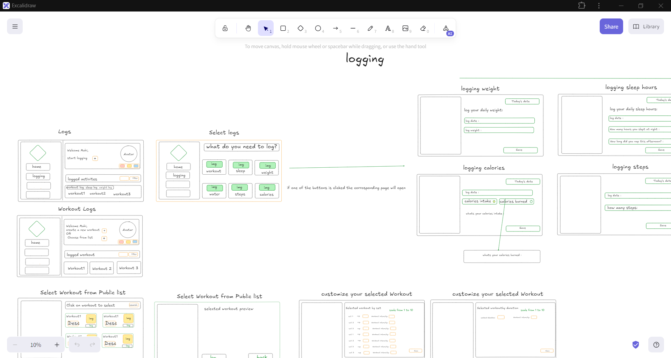
sample of wireframe

Slide 21
Project Analysis
Data flow Diagram DFD Level0 (Context Diagram)

Slide 22
Project Analysis
Data flow Diagram
DFD Level1

Slide 23
Project Analysis
Flowchart Diagram

Slide 24
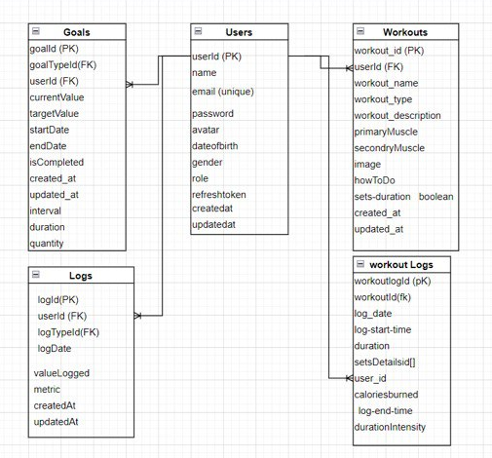
Project Analysis
Entity Relation Diagram (ERD) Diagram

Slide 25
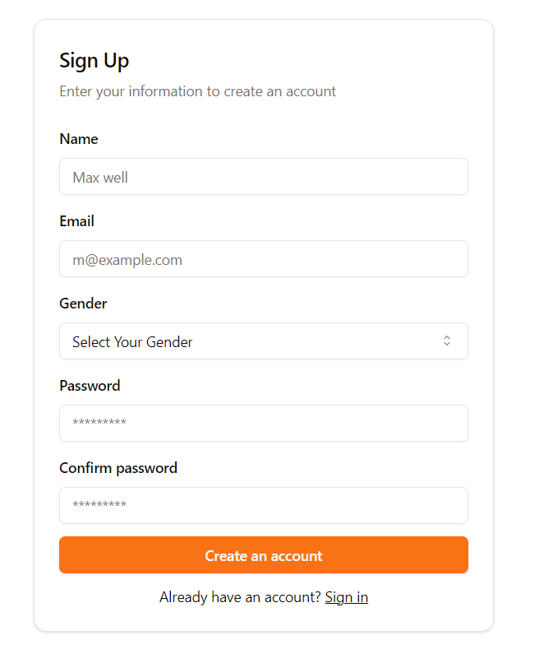
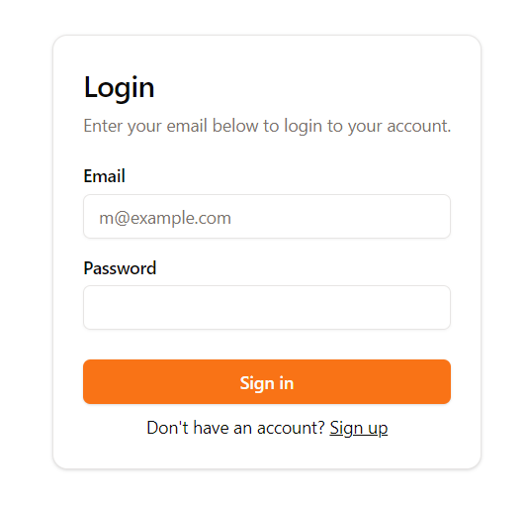
Implementation
1. Authentication Pages
Hossam Frontend & Backend

Slide 26
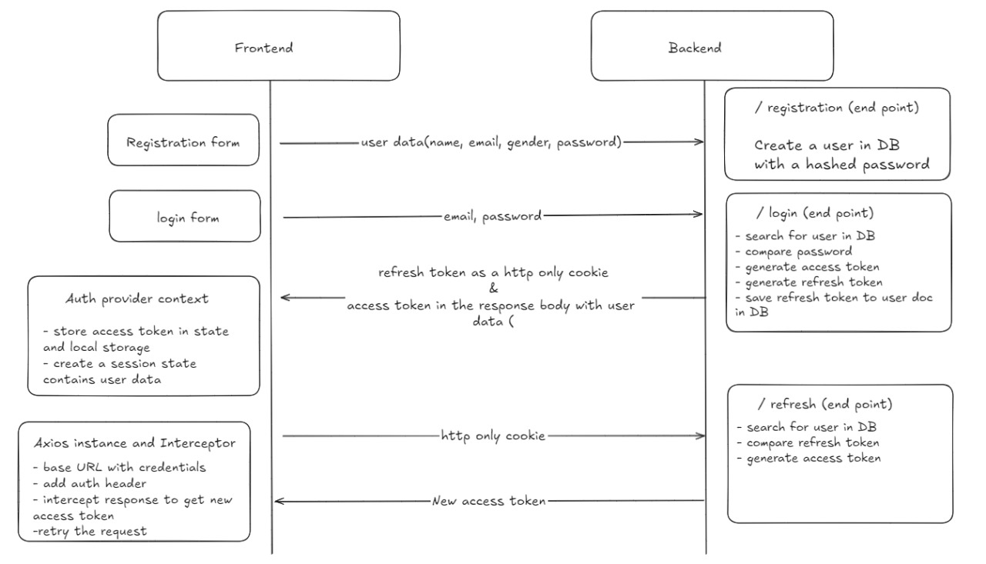

Slide 27
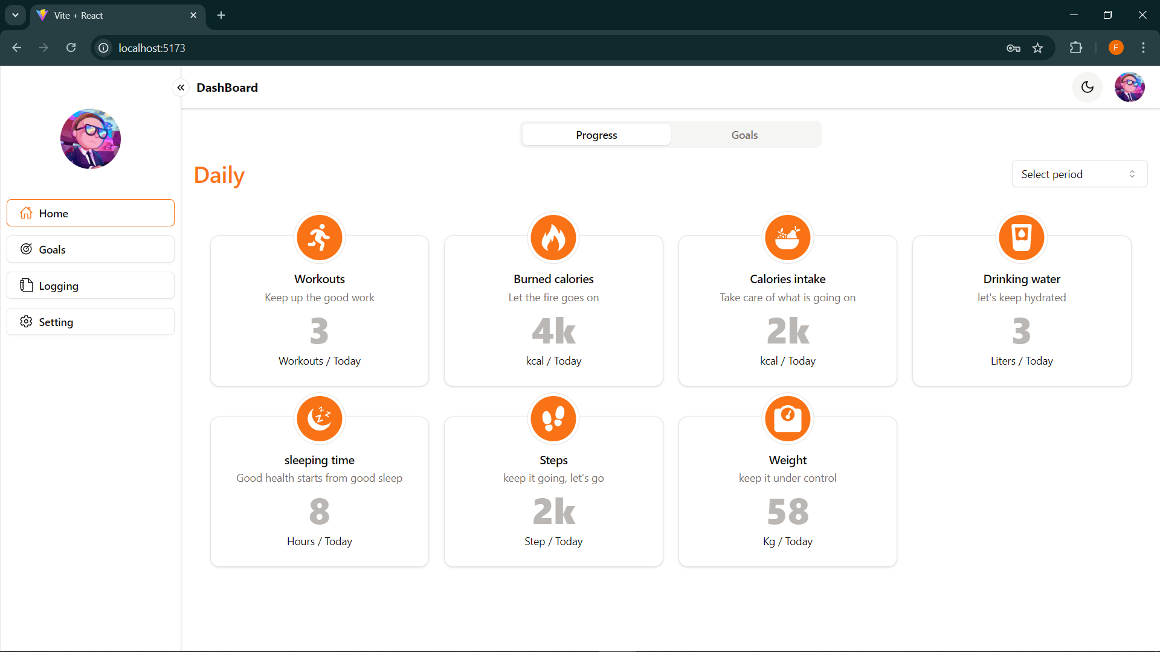
Implementation
2. Home Page (progress)
Nahla Frontend
Mahitab Backend

Slide 28
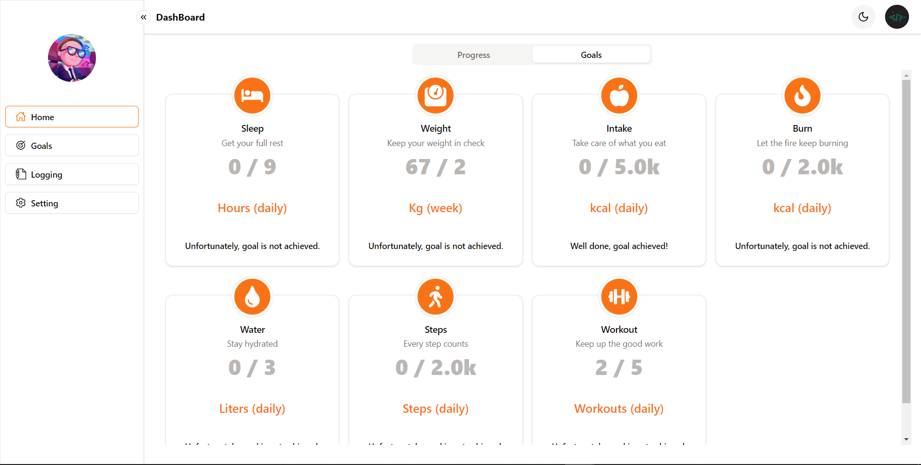
Implementation
2. Home Page (goals)
Nahla Frontend
Mahitab Backend

Slide 29
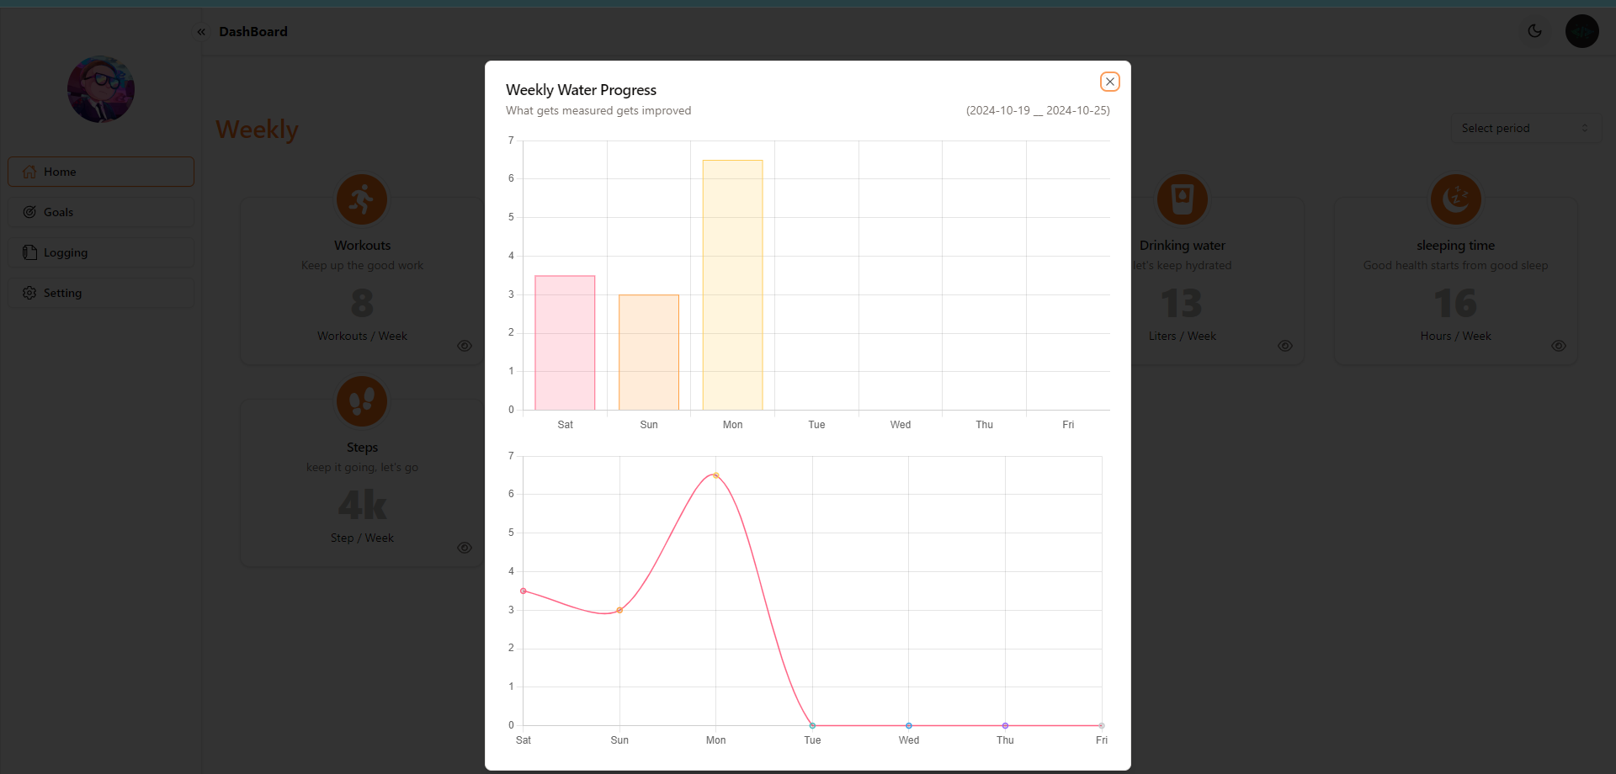
Implementation
2. Home Page (charts)
Nahla Frontend
Mahitab Backend

Slide 30
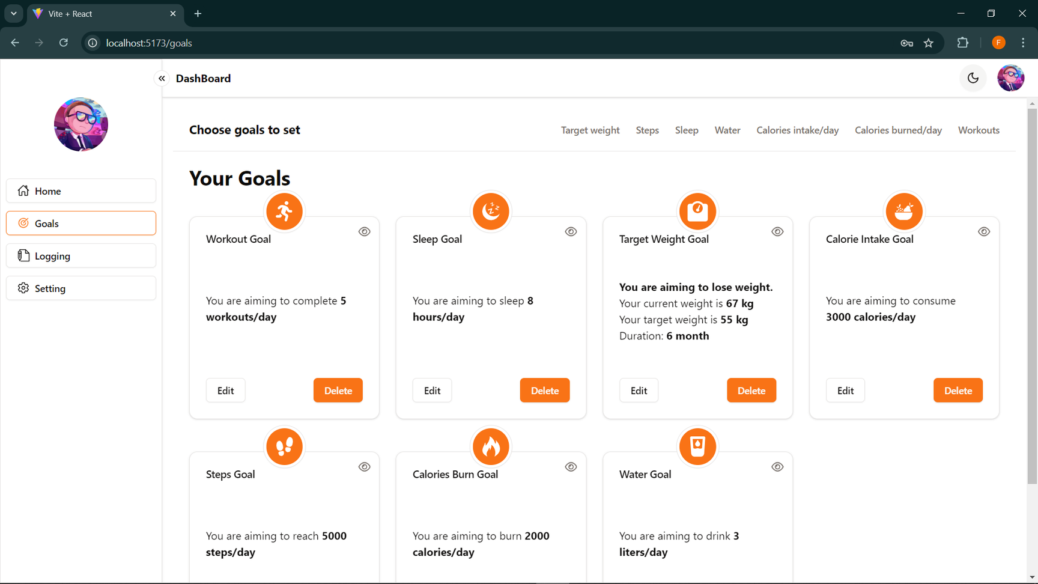
Implementation
3. goals Page
Fatma Frontend
Mahitab Backend

Slide 31
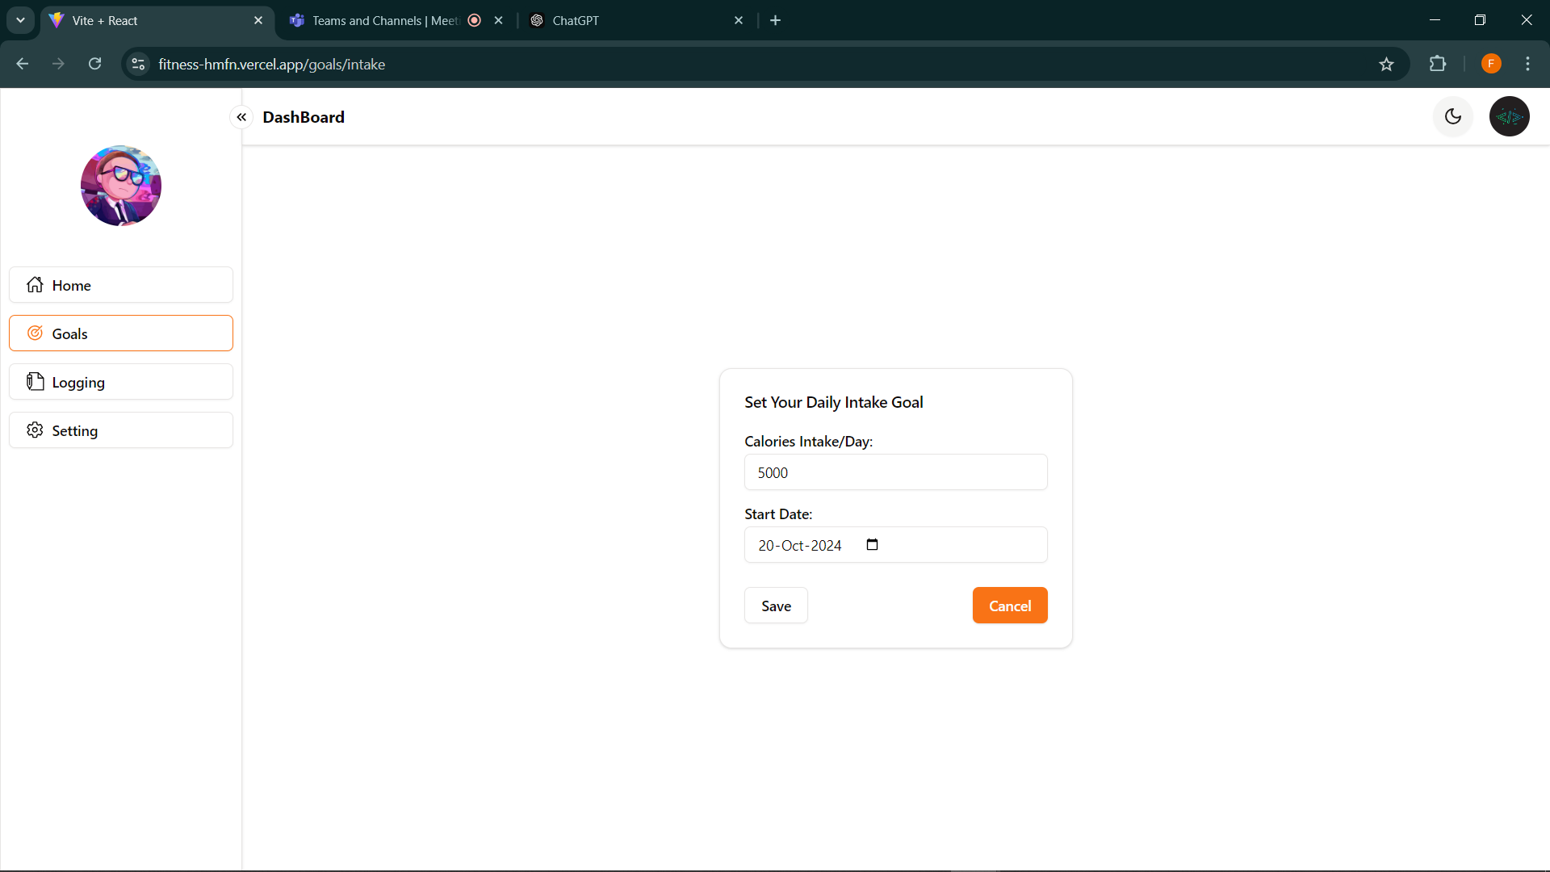
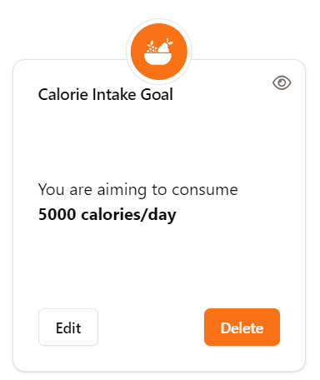
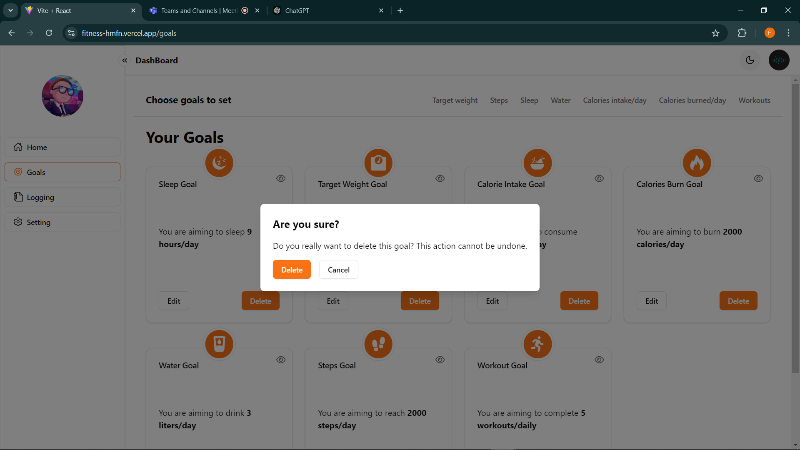
Implementation
3. goals Page (edit & delete)
Fatma Frontend
Mahitab Backend

Slide 32
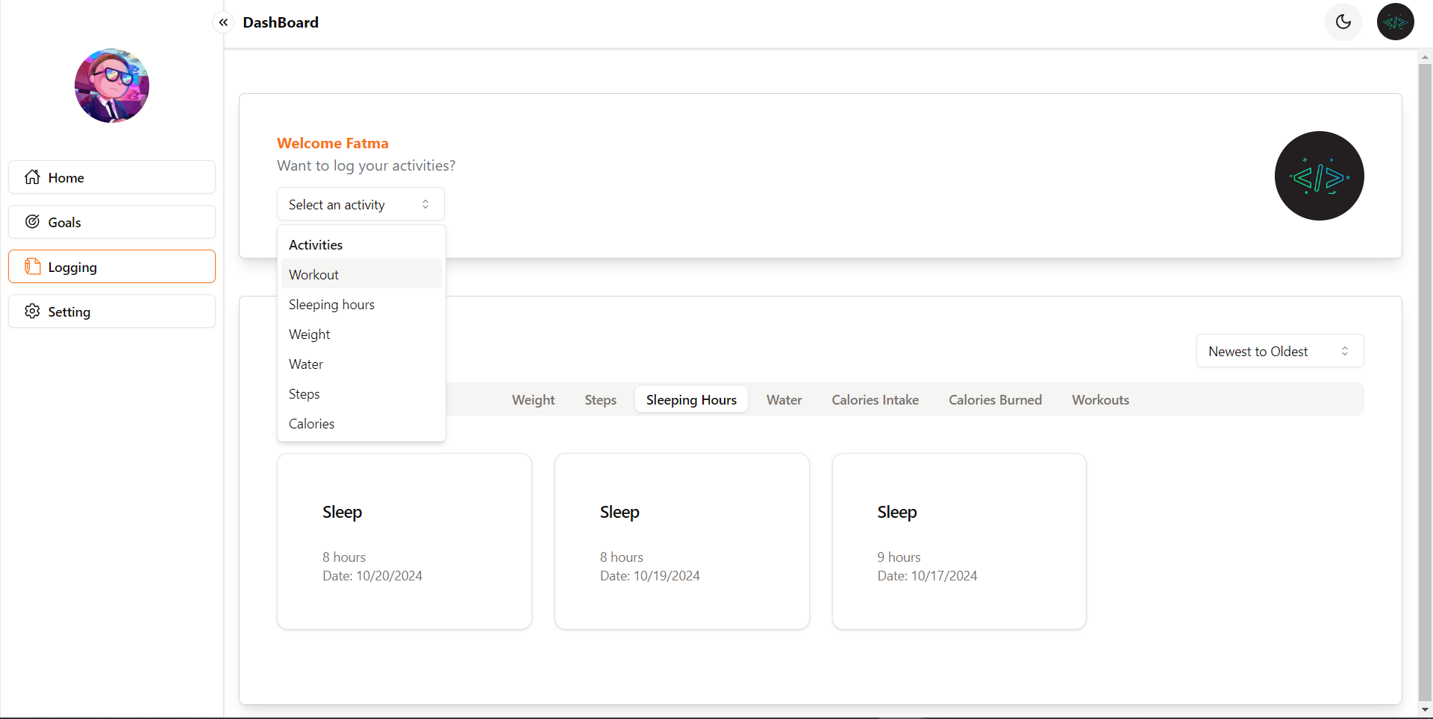
Implementation
4. logging Page
Nahla Frontend
Mahitab Backend

Slide 33
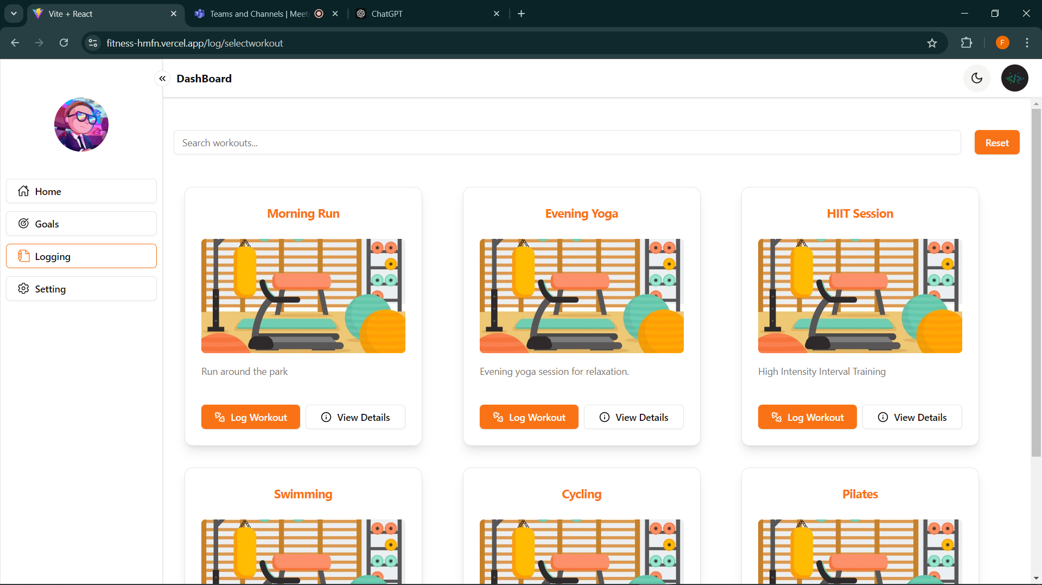
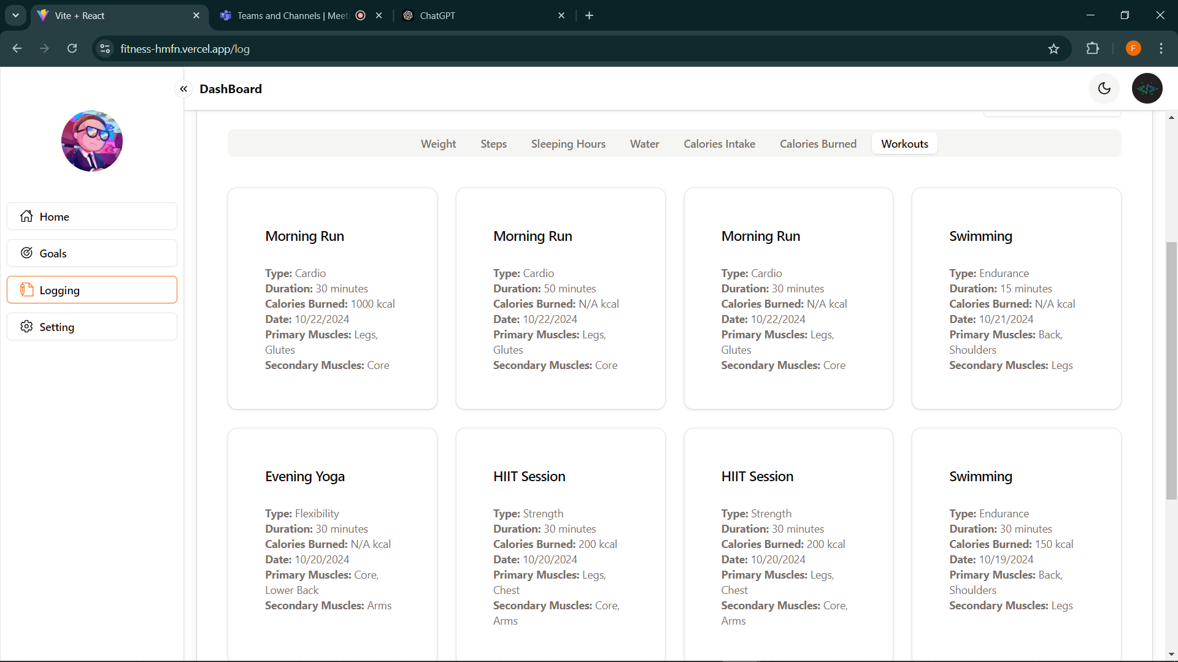
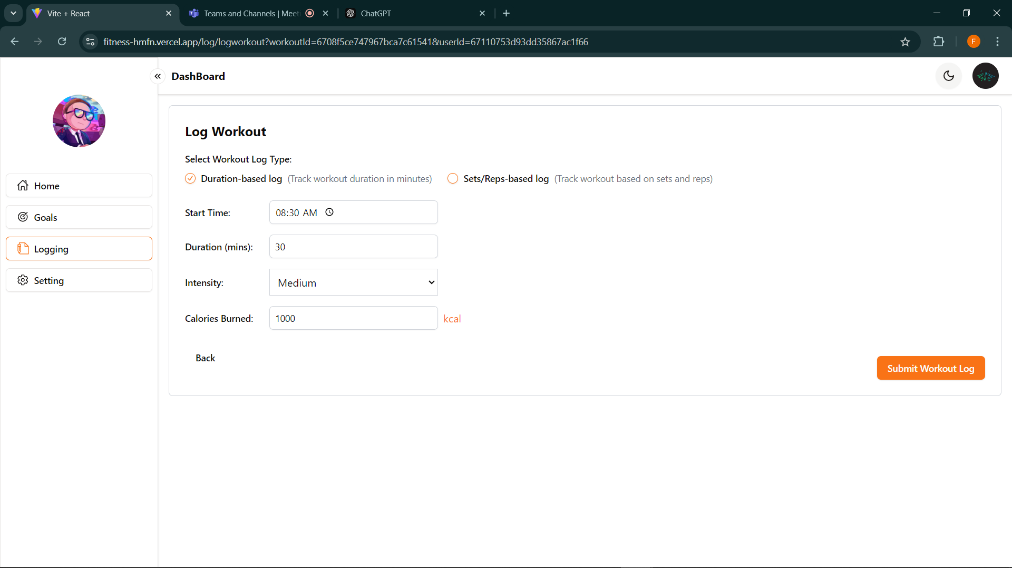
Implementation
4. logging Page (workout log)
Nahla Frontend
Mahitab Backend

Slide 34
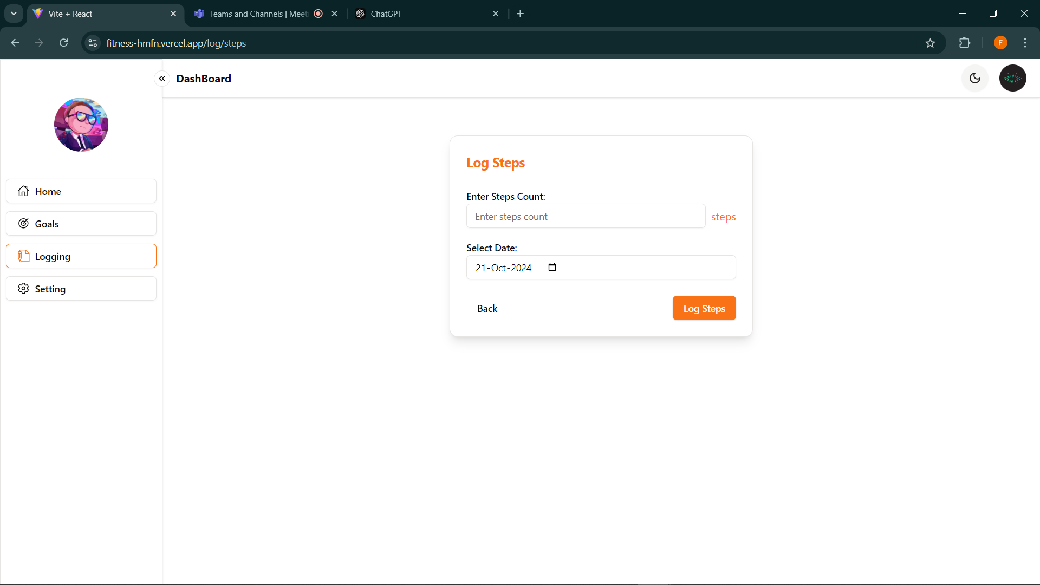
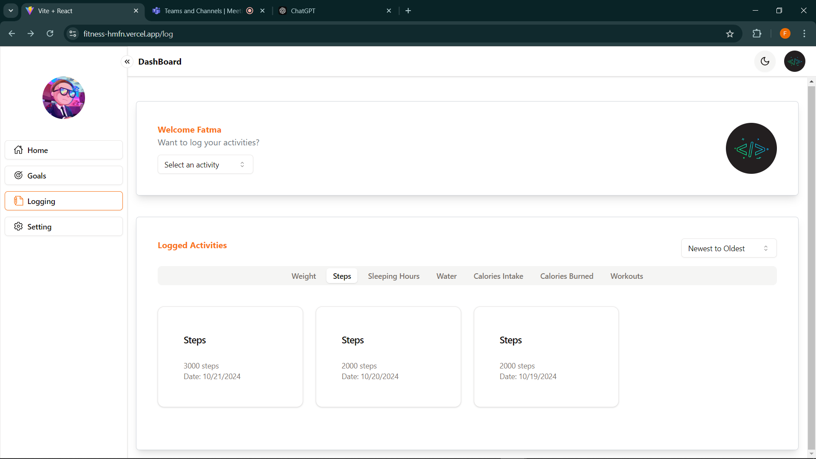
Implementation
4. logging Page (E.G., steps log)
Mahitab Frontend & Backend

Slide 35
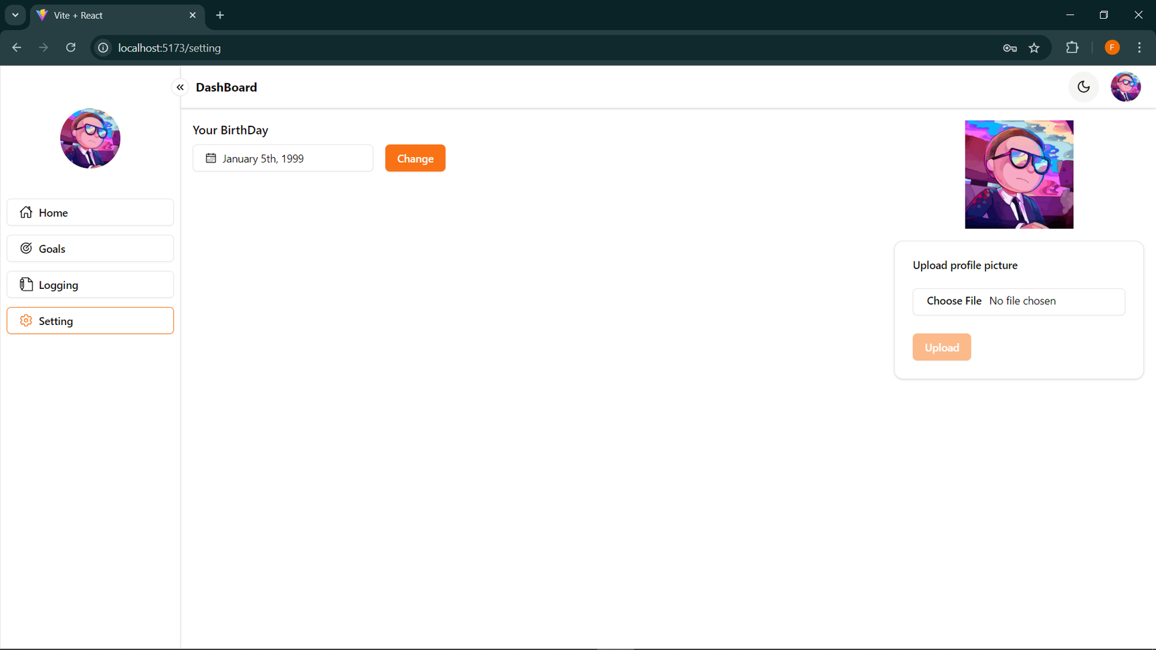
Implementation
5. setting Page
Fatma Frontend
Hossam Backend

Slide 36
Stage2 (Future work)
Add Admin:
Define public workouts, manage food, track client progress, manage trainers and nutritionists, and remove staff as needed.
Users can log custom workouts
Stage3 (Future work)
Add Trainer:
Add Workout, Edit Workouts, Delete Workouts, Track Client Progress, Manage Clients
Stage4 (Future work)
Add Nutrition & Nutritionist:
Add Predefined Food, Food Specifications

Slide 37
Future work
Stage2
Add Admin:
Define public workouts, manage food, track client progress, manage trainers and nutritionists, and remove staff as needed.
Users can log custom workouts
Stage3
Add Trainer:
Add Workout, Edit Workouts, Delete Workouts, Track Client Progress, Manage Clients
Stage4
Add Nutrition & Nutritionist:
Add Predefined Food, Food Specifications

Slide 38
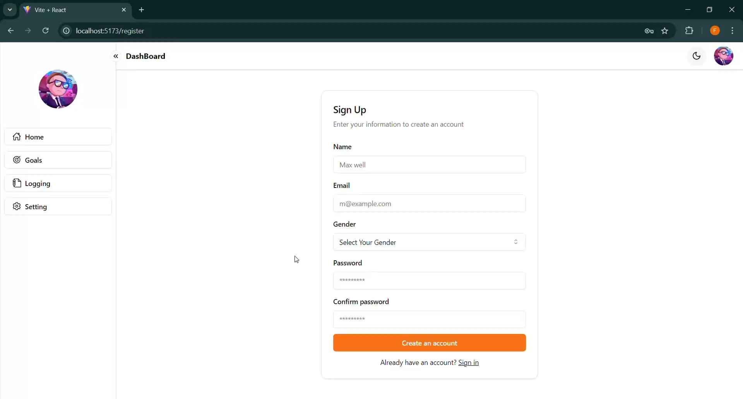

Slide 39
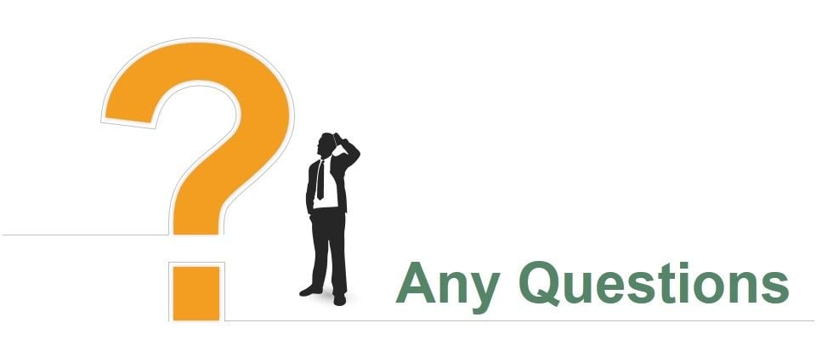

Slide 40


